Slide 1
Chapter 6
Heapsort

Slide 51
Assumes that the trees Left(i) and Right(i) are max-heaps, but that A[i] might be smaller than its children.

Slide 82
Build-Max-Heap
Loop invariant: At the start of every iteration of for loop, each node i + 1, i + 2, . . . , n is the root of a max-heap.

Slide 83
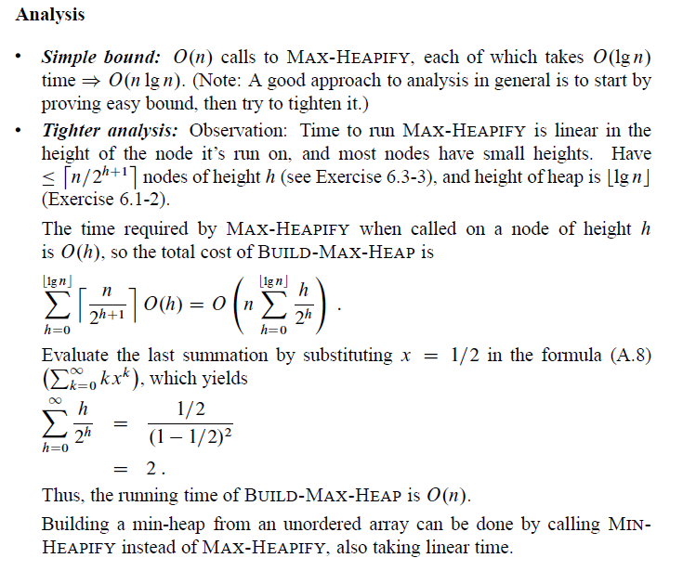
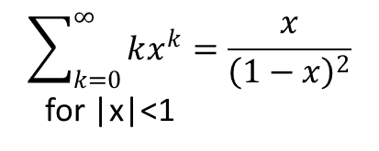
Build-Max-Heap
$$\sum_{k=0}^{∞}{kx^{k}=\frac{x}{{\left(1−x\right)}^{2}}}$$
for |x|<1

Slide 117
7 Return max

Slide 125
//

